Slide 1

Leveraging AI to Mitigate KRAS Resistance to KRAS Inhibitors
Archi Marrapu, Research Trainee @ Karolak Lab
Moffitt Cancer Center, Machine Learning Department
Notes:
"Hello everyone, and thank you for joining us for today’s seminar. My name is Archi Marrapu, and I am honored to be a Research Trainee at the Karolak Lab within the Machine Learning Department. I’m going to be sharing some work that I have been doing for over two months about Leveraging Advanced Technology to Mitigate KRAS Resistance in the Binding Site of KRAS Inhibitors and I am excited to share with you the transformative role that machine learning plays in shaping the future of drug discovery."

Slide 2
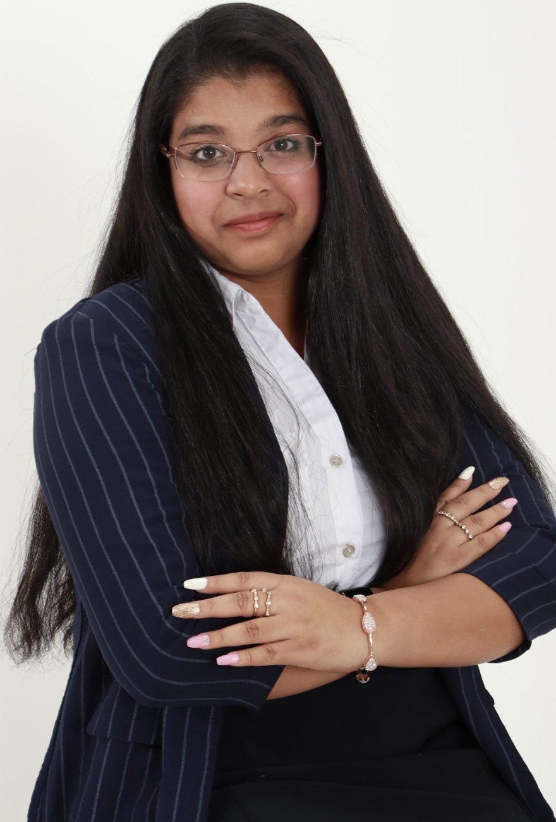
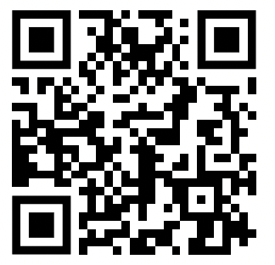
About Me
Rising 11th grader at Thomas Jefferson High School for Science and Technology
Passionate about interdisciplinary fields of medicine, biomedical engineering, and Artificial Intelligence
Public speaker and STEM advocate for women’s empowerment
Notes:
So, before I begin, I’d like to share a little bit about myself. I am a rising junior at Thomas Jefferson High School for Science and Technology in northern Virginia. I’m extremely passionate about the interdisciplinary fields of biomedical engineering and Artificial Intelligence in the medical fields to solve key problems that people face globally. I’ve done many projects in this field such as an AI Powered Prosthetic Arm, an app to diagnose melanoma skin cancer at the click of a button, and an extremely smart and holistic pill tracking and dispensing system that solves problems with medical adherence and prescription drug abuse, which I called Project Pill Tracker. I’ve published three research papers so far, presented some of my work at an IEEE conference, and gained a lot of recognition for my most recent project which was Project Pill Tracker. This project got awards from many science fairs, the COMMISSIONED OFFICERS ASSOCIATION OF THE U.S. PUBLIC HEALTH SERVICE, IEEE, and more. I recently got the Student Achievement award from the Washington Academy of Sciences for all my work in the field. In addition to my personal passion, I am a strong STEM advocate for women's empowerment and have given over 50 speeches or talks in the DC Maryland and Virginia area. I really love public speaking and Im proud to say that I just gave my first Tedx talk last week. I also love to dance and have been doing Indian classical dance for over 13 years now.

Slide 3
Our Study
Exploring the frontier of drug discovery in cancer treatment for better results
Harnessing cutting-edge technology, such as Artificial Intelligence
Comparative analysis of potential drugs for informed decisions about efficiency & safety
Overall Goal = Identify KRAS inhibitors to prevent binding resistance
Notes:
So just a brief overview about our study. Through this project, we are exploring the frontier of drug discovery in cancer treatments to yield better results. And to do this more effectively and accurately, we are harnessing advanced cutting edge technology such as Artificial Intelligence. Our overall goal for this study is to identify a list of KRAS inhibitors to prevent resistance to the KRAS binding site and our approach for this project includes a comparative analysis to identify these potential drugs so that researchers can make informed decisions about their efficiency and safety.

Slide 4
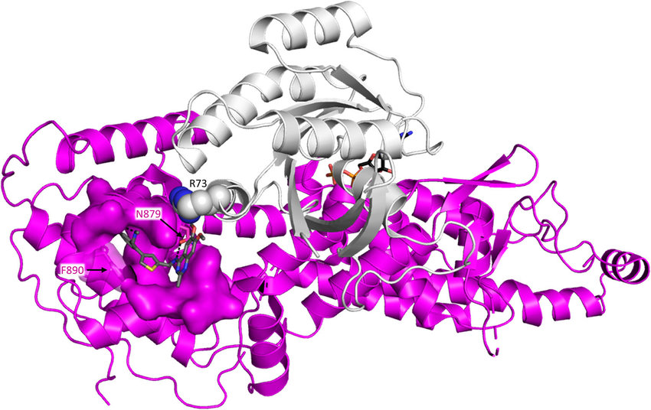
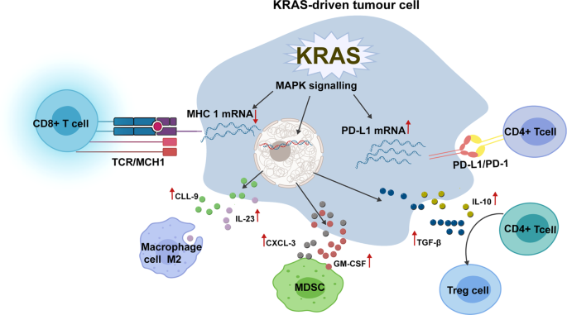
KRAS (Kirsten rat sarcoma)
Gene that codes for a protein involved in cell signaling pathways
Critical in cell division and growth
KRAS gene mutations are associated with various cancer types
Mutation leads to continuous cell growth and division
KRAS binding site and inhibitors
https://www.researchgate.net/figure/Binding-site-of-compounds-perturbing-KRAS-SOS-interaction-on-the-surface-of-SOS-S9-bound_fig4_343226352
https://media.springernature.com/lw685/springer-static/image/art%3A10.1038%2Fs41392-021-00780-4/MediaObjects/41392_2021_780_Fig4_HTML.png

Slide 5
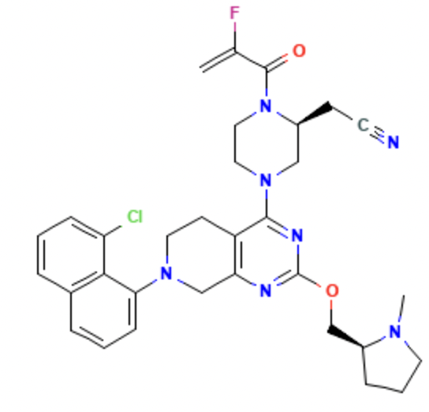
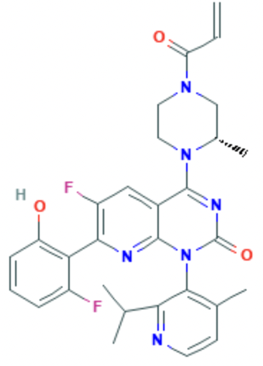
Example Drugs
Adagrasib
Sotorasib
MRTX849
AMG 510
https://pubchem.ncbi.nlm.nih.gov/compound/Adagrasib
https://pubchem.ncbi.nlm.nih.gov/compound/Sotorasib

Slide 6
Purpose
Inhibitors for KRAS took decades to find
First inhibitors were Sotorasib (FDA approved) and Adagrasib
Over time, KRAS develops resistance to its inhibitors and requires new inhibitors
Using AI to help trials and increase efficiency
Our goal is to create a KRAS specific library of fragments that will help target resistance
Fragment based drug discovery is in line with Moffitt research

Slide 7
Fragment-Based Drug Discovery (FBDD)
Recognized approach in drug discovery which focuses on small molecular fragments
Overall FBDD process:
Fragment Library: Begin with diverse collection of small chemical fragments
Screening: Test fragments against target to identify interactions.
Hit Expansion: Modify fragments for improved binding.
Growth & Linking: Combine or link fragments to create larger compounds.
Iterative Optimization: Refine compounds for enhanced potency.
Our approach uses Deconstruction-Reconstruction method
Notes:
Our approach to drug discovery focuses on small molecular fragments, a strategy known as Fragment-Based Drug Design (FBDD). Here's how we carry it out:
Fragment Library: We start with a diverse collection of small chemical fragments. These are like puzzle pieces that could potentially fit into a larger picture – in this case, a molecule that interacts with a disease-related target.
Screening: We test these fragments against a specific target, usually a protein associated with a disease. We're looking for fragments that show promising interactions with the target.
Hit Expansion: When we identify these promising fragments, we work on enhancing their binding affinity with the target. This involves modifying their structures to make them better fit into the target's binding site.
Growth & Linking: We then explore combining these modified fragments to create larger compounds. This step involves strategically assembling the fragments to produce molecules with improved binding properties.
Deconstruction-Reconstruction: Our approach involves breaking down larger molecules into smaller, constituent fragments, and then reconstructing them in a way that maintains or enhances their binding capabilities.
Iterative Optimization: Finally, we refine these compounds through iterative processes. We make precise adjustments to optimize their binding strength and reduce potential side effects.
In summary, our innovative method relies on starting with small molecular fragments and systematically building compounds with optimized interactions with disease-related targets. This approach holds the potential to unlock new avenues in drug discovery by leveraging the unique properties of these fragments.

Slide 8
Deconstruction-Construction Approach
Deconstruction: dividing a drug molecule into smaller fragments
Construction: reassembling fragments into new compounds
Step 1: Deconstruction
Step 2: Fragment Analysis
Step 3: Construction
Dissect known drug into functional groups or fragments
Identify essential parts for target binding.
Examine fragments for interaction with target protein
Assess binding affinity, selectivity and binding mode
Combine fragments to create novel compounds
Optimize binding affinity and drug-like properties

Slide 9
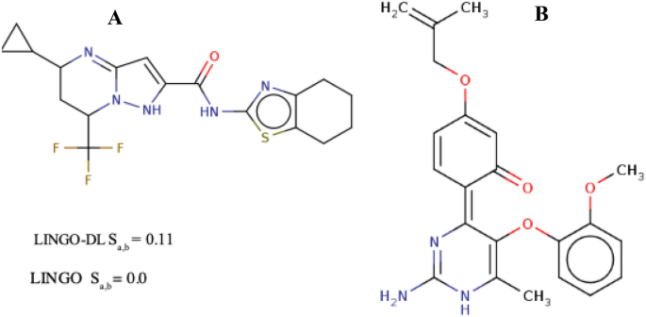
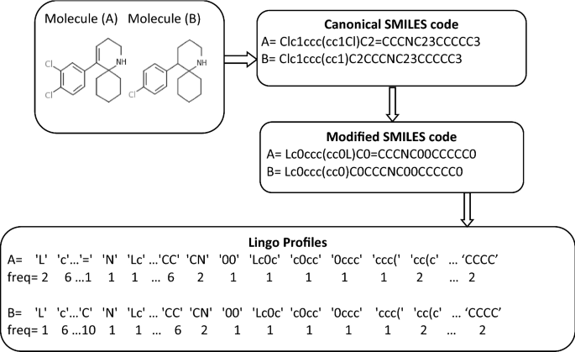
Previous Studies: Lingo-DL
Text representation of drug chemical structures
SMILES = Simplified Molecular Input Line System
Deep learning (RNN) method creates fragments
Compares chemical fragments to find the similarity
Chemical sense is lost in the process
https://link.springer.com/article/10.1007/s10822-021-00383-9

Slide 10
Research Questions
How can we identify most potential fragments using chemical structures?
How can we utilize AI as a tool to assist us in this process?
How can we preserve the chemical sense?

Slide 11
Our Approach
Step 1: Upload Fragment Library File
Step 2: Reference Molecules (KRAS Inhibitors)
Step 3: Similarity Search (Tanimoto Indices)
Step 4: Filter File for Best Candidates
Step 5: Add SwissADME Descriptors
Finding drug fragments similar to reference molecules:
Adagrasib
Sotorasib
Input file is an enamine library

Slide 12

SMILES Representation
Text-based notation to represent chemical structures.
Widely used for communication, storage, and analysis of molecular information.
SMILES codes used to represent individual fragments of molecules in FBDD
Canonical vs noncanonical representations
Used in our current approach
https://pubchem.ncbi.nlm.nih.gov/compound/Adagrasib#section=InChI

Slide 13
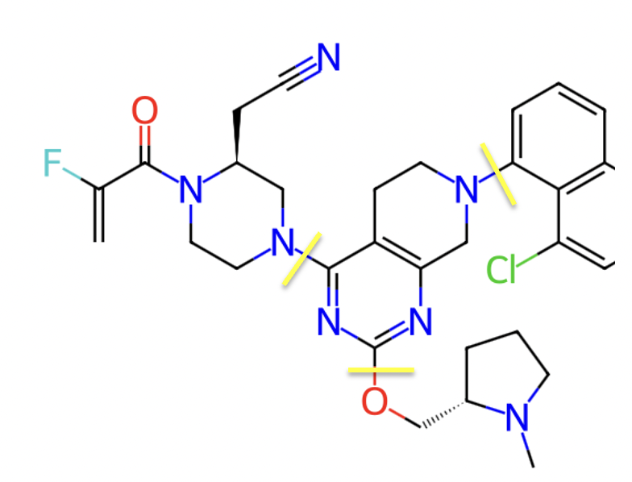
Drug Defragmentation
Chemical structure for drugs can be defragmented at rotatable single bonds
Fragmented SMILES representations
Model to compare the fragmented SMILES
Language based comparison
Chemical comparison

Slide 14
Fragment Comparison Model
Chemical-Based Model
Language-Based Model
Direct representation of molecular features and interactions
Suitable for structure-activity relationship analysis
Different Approaches:
Pharmacophore Modelling
Fingerprinting
Enables text-based similarity comparisons
Supports computational analysis using natural language processing
Different Approaches:
SMILES Encoding
International Chemical Identifier (InChl)

Slide 15
Similarity Score Between Drug & Fragment Libraries
Tanimoto Index (Jaccard Coefficient) = Number of Common Features/Total Number of Features
The Tanimoto Index is a widely used metric to quantify similarity between molecules.
It's particularly useful in fragment-based drug discovery and virtual screening.
Step 1: Generate Fingerprints
Convert molecular structure into fingerprint
Identify features like functional groups, atoms, and bonds
Step 2: Calculate Similarity
Count the number of common features between molecules
Count the total number of features in both molecules
Step 3: Apply Formula
Divide the number of common features by total features
Obtain Tanimoto index 0 – 1, 0 = no similarity, 1 = complete similarity

Slide 16
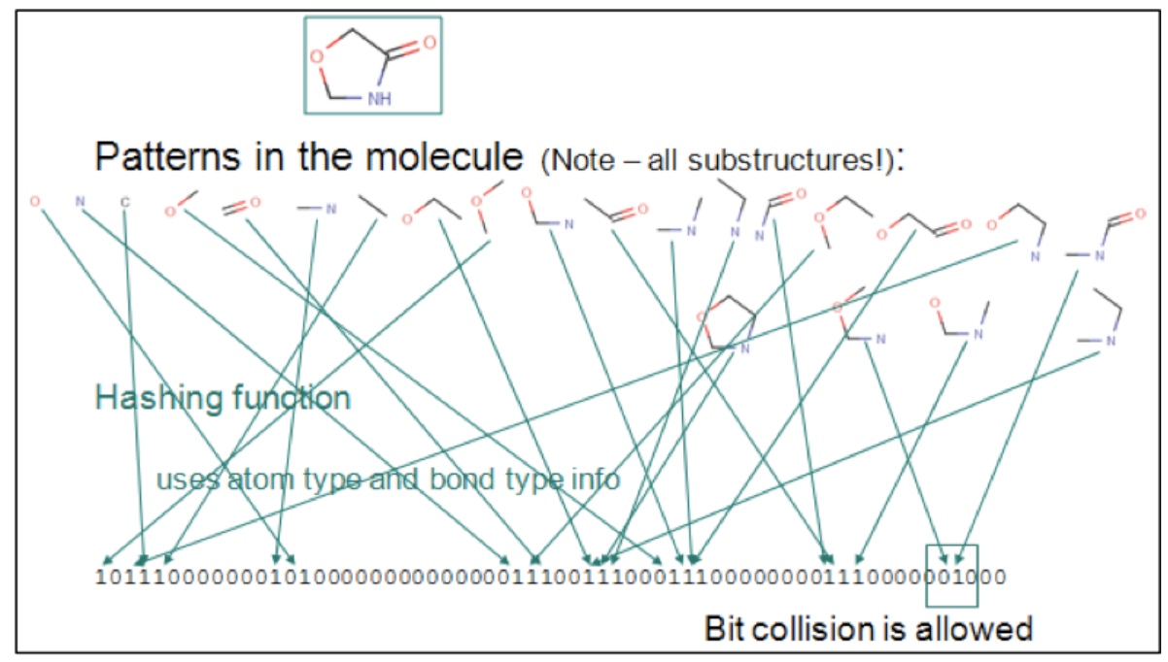
Tanimoto Picture

Slide 17
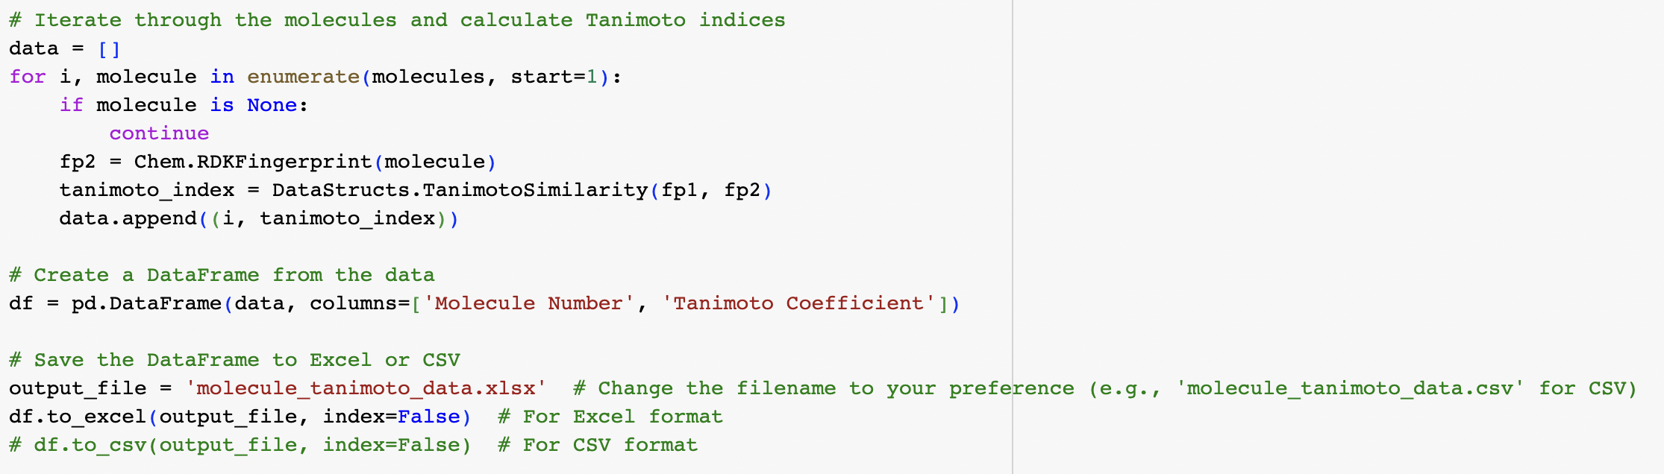
My Work Highlights
Automation of Tanimoto Index extraction for over 640 molecules

Slide 18
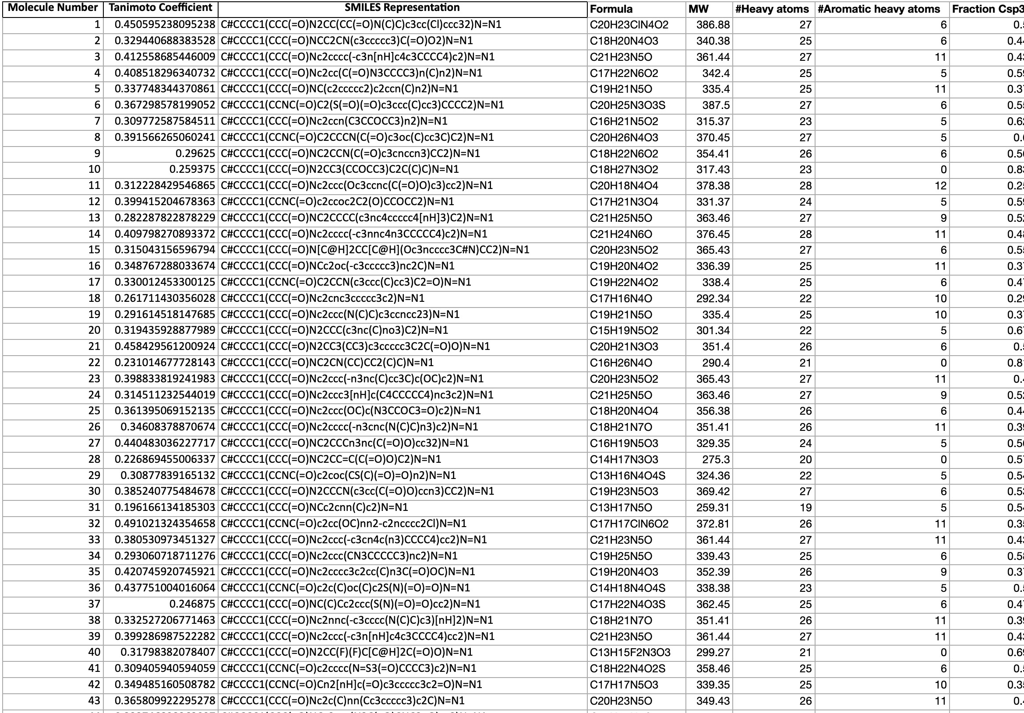
My Work Highlights
Automation of Tanimoto Index extraction for over 640 molecules
Combining Tanimoto Indices + SwissADME Descriptors into single file

Slide 19
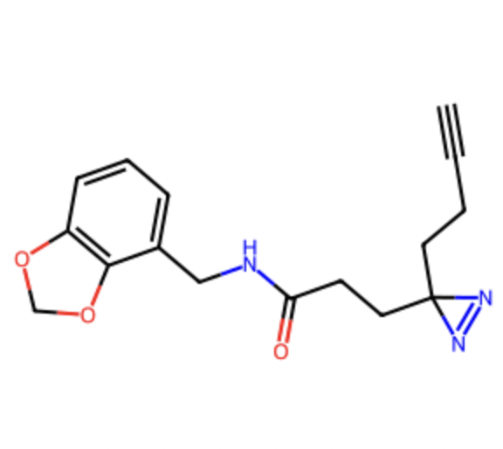
My Work Highlights
Automation of Tanimoto Index extraction for over 640 molecules
Combining Tanimoto Indices + SwissADME Descriptors into single file
Automatically generating chemical images of the molecules in library

Slide 20
Output Data
Notes:
This table is what will go to next steps, I have 20 more weeks and will be using this as input for ML models

Slide 21
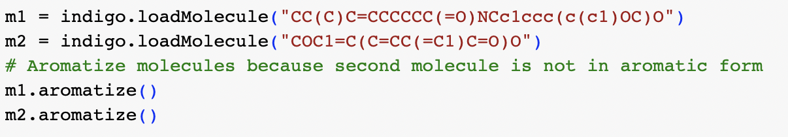

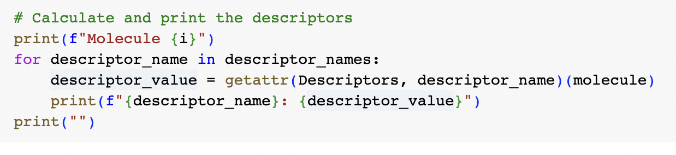
Initial Code
Indigo Library
Tversky Similarity
Python Descriptors

Slide 22
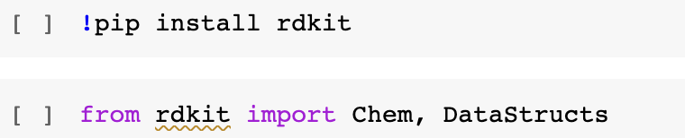



Current Code
Rdkit Library
Tanimoto Similarity
SwissADME Descriptors

Slide 23
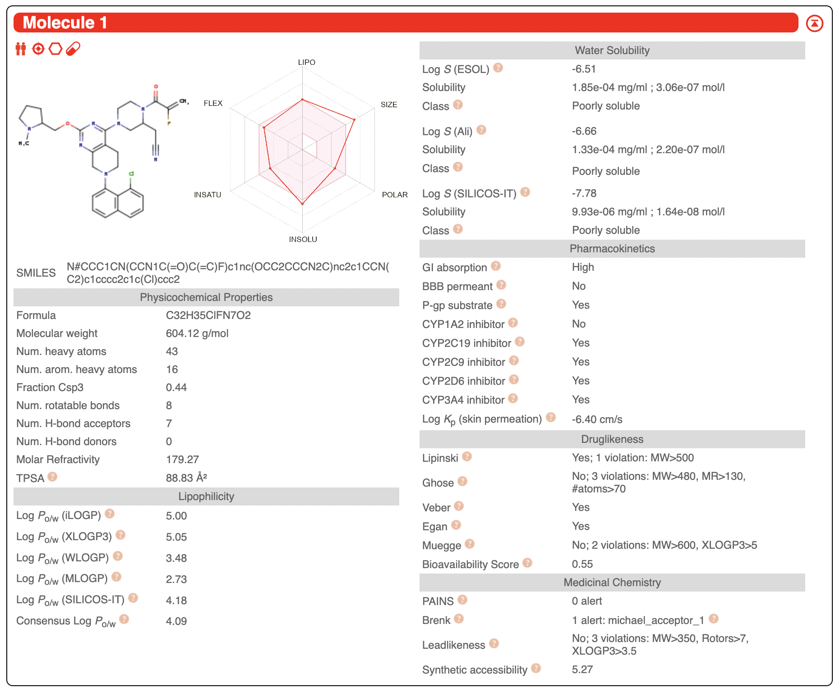
SwissADME
The web-based tool for predicting the Absorption, Distribution, Metabolism, Excretion, and Toxicity (ADMET) properties
Utilizes computational models based on established data.
http://www.swissadme.ch/index.php

Slide 24
Machine Learning Model
Regression Model
Random Forest
Neural Networks
Quantitative prediction
Uses molecular properties
For optimal performance, may need feature engineering
Handles nonlinear relationships
Hyperparameters tuning for model optimization
Requires validation with data
Captures intricate patterns
Handled high dimension data
Requires substantial labeled datasets and transfer learning
Notes:
Make predictions and identify fragments

Slide 25
Unsupervised & Supervised Learning
Techniques enhance fragment analysis in drug discovery
Uncover insights, classify fragments, and identify potential hits
Supervised Clustering of Fragments
Unsupervised Clustering of Descriptors
Predicts fragment behavior based on similarity.
Enables targeted analysis of fragment classes
Reveals hidden patterns in fragment data.
Identifies clusters with shared characteristics.

Slide 26
Future Steps
Advanced ML Models
Multimodal Data Integration
Dynamic Property Incorporation
Experimental Validation
Enhanced Data Quality
Visual Molecular Interactions

Slide 27
Real World Applications & Extensions
Identifying potential drug candidates from large compound libraries
Refining and enhancing lead compounds
Assessing potential toxic effects of compounds
Identifying new uses for existing drugs
Precision Medicine: Tailoring treatments to individual patient profiles
Predicting interactions between drugs and specific targets
Notes:
Lead compound as in Leading compound

Slide 28
Acknowledgements
Thank you so much for all your help:
My family
Dr. Alexandra Karolak
Karolak Lab team members

